Slide 1

CT –3089
COMPUTER TECHNOLOGY AND APPLICATION Department
PRESENTATION ON :
STUDENTWORLD.COM
GUIDED BY: SUBMITTED BY:
Mrs. Varshali Jaiswal Rahul Bansal
Vikas harle
Vishvesh Mishra
Shri G.S. Inst. of Tech. & Science

Slide 2
Contents…
Abstract
Introduction
Limitations in existing system
Manual system
Major Operation
User:-Admin , Student
Hardware & Software Requirement
Flow Diagrams
Conclusion
Screen Shots
Reference

Slide 3
Abstract
The aim of the project is to provide books, notes and sharing of events online that will provide minimum cost of book, sharing of books and information about event.

Slide 4
Introduction
It is based on java technology project made for the students.
The StudentWorld.com prepared to provide all categories of books, notes and helps in various types of books.
It facilitate candidates to register & search as well as upload books and, manage their accounts etc.

Slide 5
Limitations in existing system
Books, Notes, Events Detail searching is very difficult.
Time consuming.
Complete detail not always available.
High cost for searching a Books, Notes, Events Detail.
No database/system to track of particular student.

Slide 6
Manual system
24X7 online facility.
No duplication of Books, Notes, Events Detail.
Save effort, time & cost of Student.
Books, Notes, Events Detail search and filter is now more easier, fast and accurate.

Slide 7
Major Operations
A major operation defines a function of a system and its components. A function is described as a set of inputs, the behavior, and outputs.
Following are the Major Operation of StudentsWorld.com-

Slide 8
Registration :-User will have to registration first then we will send a confirmation link to the user email id.
Sale Details:- In this module user will fill all the information about the book which he wants to sale.
Buy Details:- In this module user can buy any book which is related to his/her stream.
Event Details:- In this module user can upload all the information of an event which is going on his/her college.

Slide 9
User
Administrator
Has full access to all the modules of this system.
Admin can Login with user ID and password.
Can view, delete and update Book details.
Admin can view, update, delete student’s and personal details.
Admin also has mail facility to all.
He can send and see student feedback.

Slide 10
Student
User can Login with provided user ID and password.
Students can sale theirs books through our website to any students.
They can also purchase books through our sides from any authorized student.
They can see event and activity details on by clicking on event module and they

Slide 11
Software and Hardware Requirement
S/W Requirement:-
java, Servlet, JSP, JDBC
My sql 5.0
Apache Tomcat 7.0 Server
H/W Requirement:-
Pentium based system
1 GB RAM
20gb HDD

Slide 12
Diagrams

Slide 13
Use Case Diagram

Slide 14
Flow Chart
Start
Is Register
Registration
No
Yes
Yes
No
Student Yes Admin
Log In
Is Authonticate
Upload & download notes
View student detail
View events information
Verify info. & send mail
Sales & buy book
Update & delete seller & buyer
View study material
Update & delete books, notes, events
Log Out
Stop

Slide 15
Class Diagram
1…n
1...n
1
1...n
1
1…n

Slide 16
CONCLUSION
Generally the students of the Colleges have to face a lot of problems for the book of particular subject and previous year notes and papers. So, there is a need to develop a system that can solve the mentioned problem. This software comes with just that solution.

Slide 17
Screen Shots

Slide 18
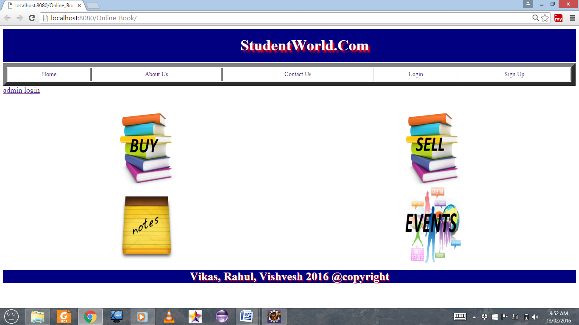
Home Page

Slide 19
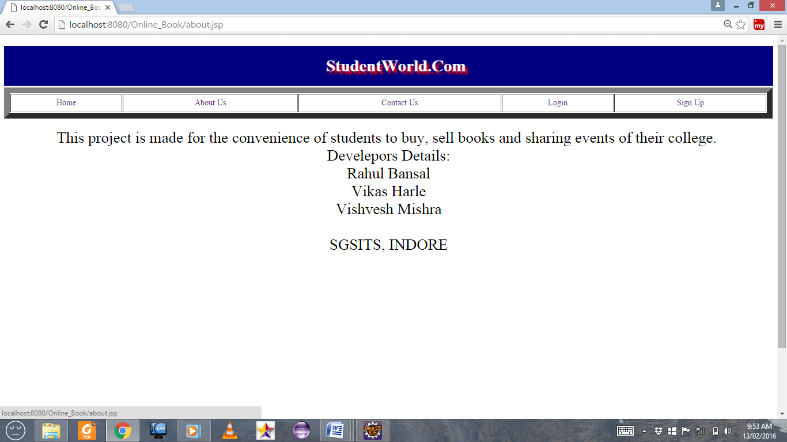
About us

Slide 20
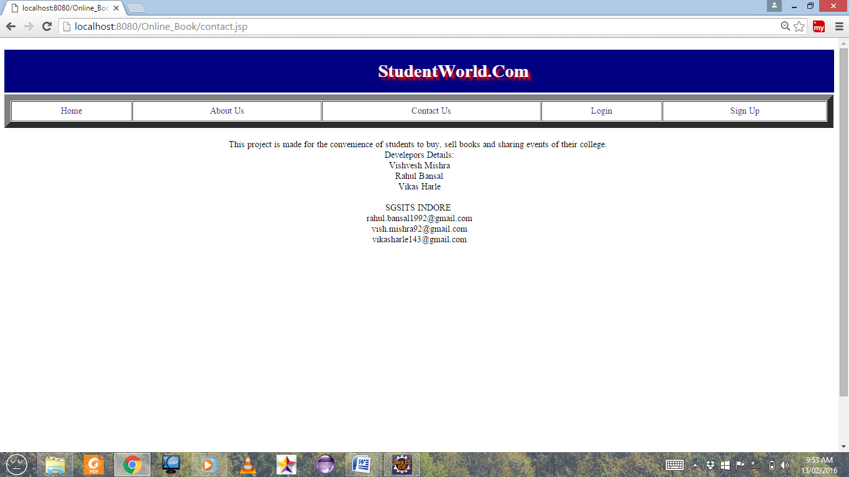
Contact us

Slide 21
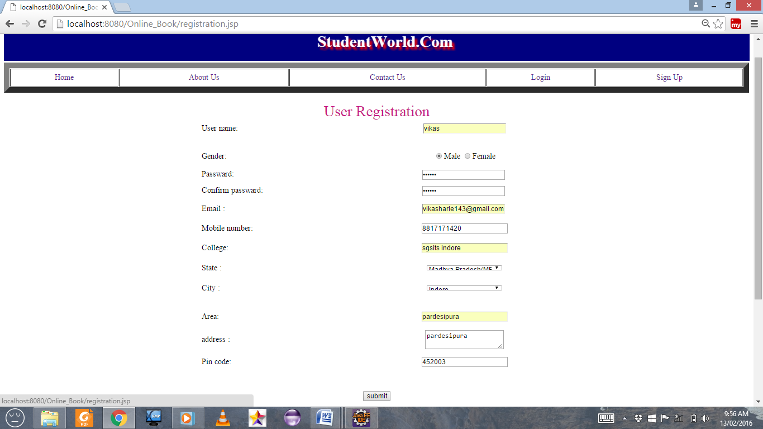
Student Registration

Slide 22
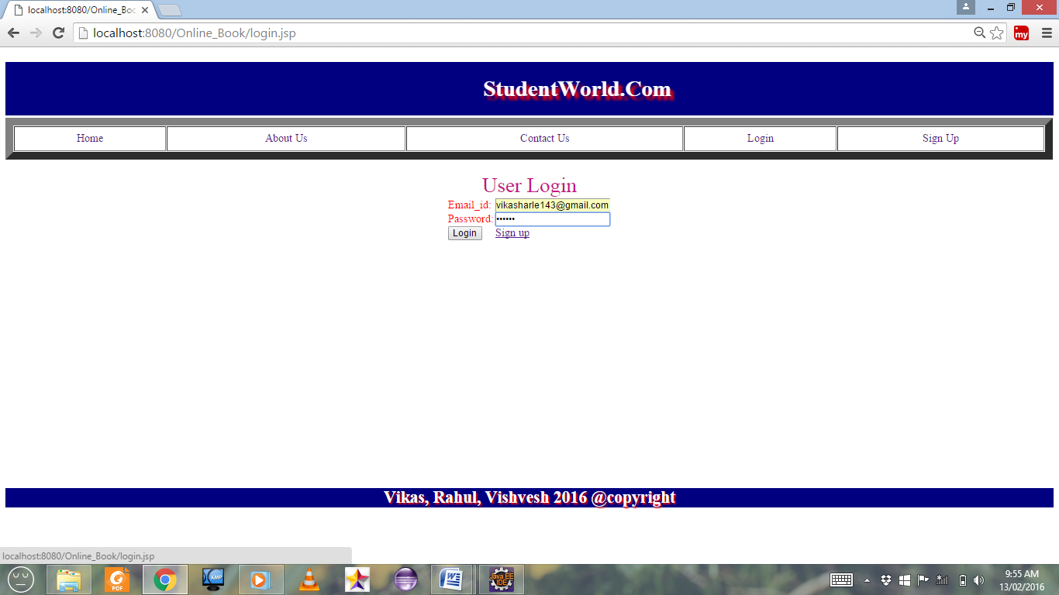
Student Login

Slide 23
REFERENCES
The Complete reference book of Java.
www.roseindia.java.com.
www.javatpoint.com.
www.java4s.com.
www.w3school.com

Slide 24


